Slide 1

CS312 Database Management Systems
School of Computer Engineering and Technology

Slide 2
CET 2002B Database Management Systems
Course Objectives:
1. Knowledge
i. Understand the fundamental concepts of database management System
ii. To provide a strong formal foundation in database concepts, DBMS architectures recent
technologies and best industry practices.
2. Skills
i. To learn the SQL database system.
ii. To program PL/SQL including stored procedures, stored functions, cursors and packages.
3. Attitude
i. To design the database system for real world applications.
ii. To access, modify, program and authenticate the database system.x
Course Outcomes:
After the completion of course, students will be able to
1. Understand the different data models
2. Implement relational database design from any data model.
3. Create database system for real world applications
4. Handle the transaction management system.

Slide 3
LABORATORY ASSIGNMENT NO: 02
SQL- DDL commands( Create, Alter, Drop, Truncate, Rename, Describe) ,DCL(Grant, Revoke)

Slide 4
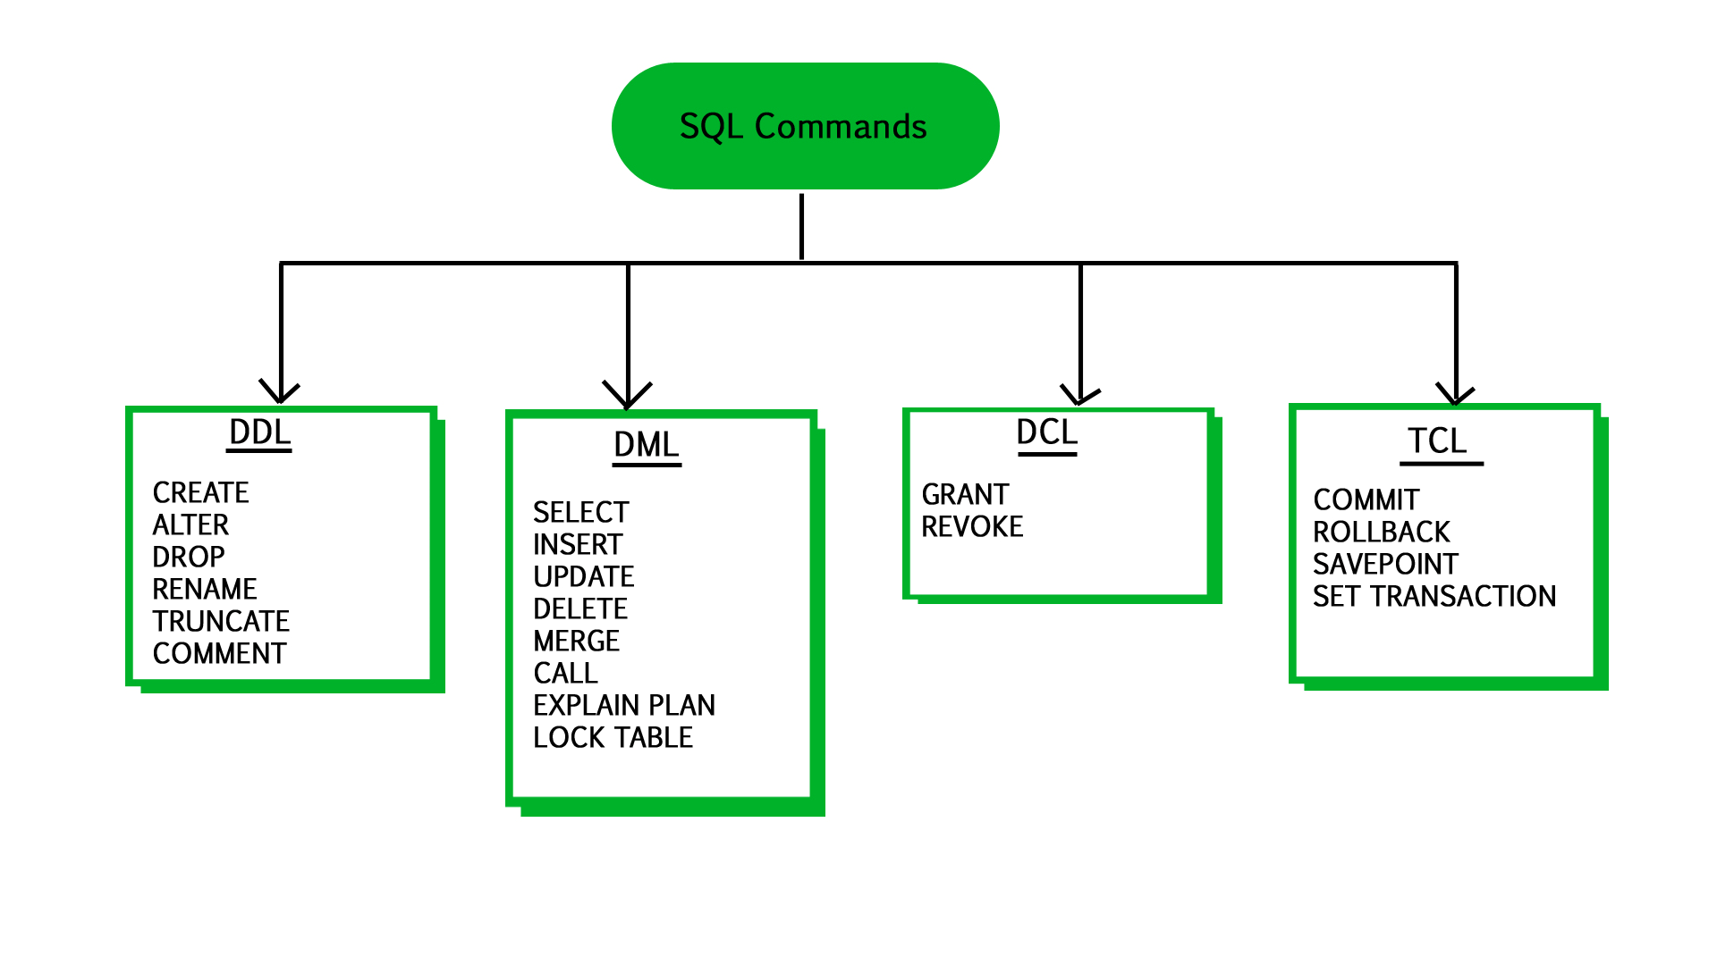
SQL Statements Categories

Slide 5
DDL Statements
CREATE TABLE - creates a new database table
ALTER TABLE - alters (changes) a database table
DROP TABLE - deletes a database table
TRUNCATE - cleans all data
RENAME- renames a table name

Slide 6
DCL Commands
GRANT- allow specified users to perform specified tasks.
REVOKE- cancel previously granted or denied permissions.

Slide 7
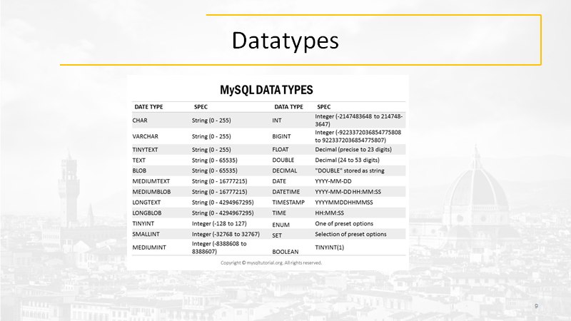

Slide 8
DDL Commands
Syntax:
CREATE DATABASE database_name

Slide 9
DDL Creating a Table
Syntax
CREATE TABLE table_name
(Column_name datatype[(size)],
Column_name datatype[(size)],
)
Example
CREATE TABLE books
(ISBN char(20),
Title char(50),
AuthorID Integer,
Price float)
Creates a table with four columns

Slide 10
MySQL CONSTRAINT
MySQL CONSTRAINT is used to define rules to allow or restrict what values can be stored in columns. The purpose of inducing constraints is to enforce the integrity of a database.
MySQL CONSTRAINTS are used to limit the type of data that can be inserted into a table.
MySQL CONSTRAINTS can be classified into two types - column level and table level.
The column level constraints can apply only to one column where as table level constraints are applied to the entire table.
MySQL CONSTRAINT is declared at the time of creating a table.
MySQL CONSTRAINTs are :
NOT NULL
UNIQUE
PRIMARY KEY
FOREIGN KEY
CHECK
DEFAULT

Slide 11
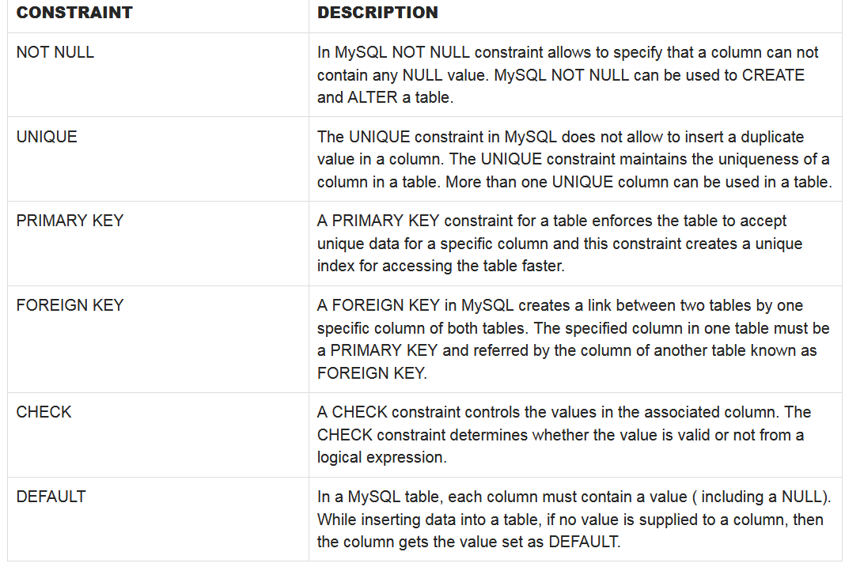
Constraints

Slide 12
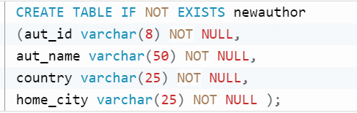
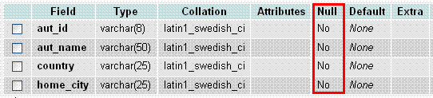
MySQL CREATE TABLE with NULL CONSTRAINT
Example
If we want to create a table 'newauthor' where no columns are allowed to store NULL VALUES the following statement can be used.
The following picture shows that the columns will not accept the NULL values.

Slide 13
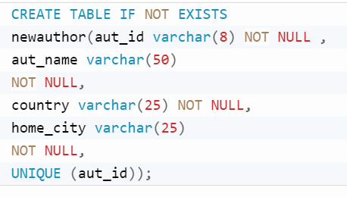
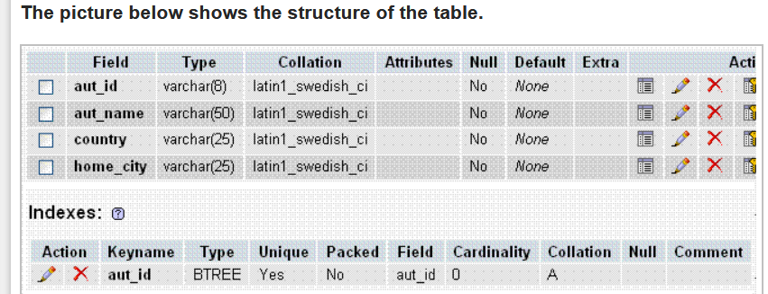
MySQL UNIQUE CONSTRAINT
Example

Slide 14
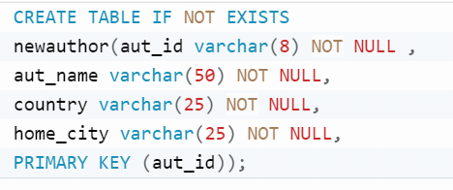
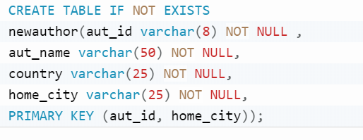
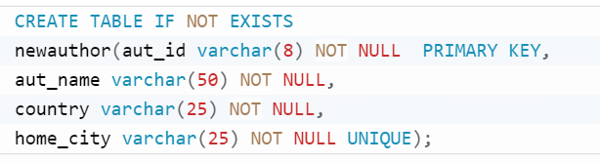
MySQL PRIMARY KEY CONSTRAINT on Single and Multiple Columns
Example

Slide 15
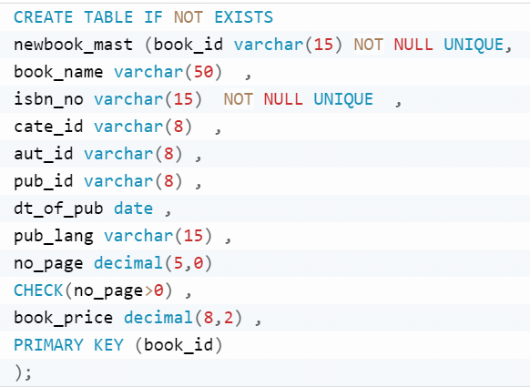
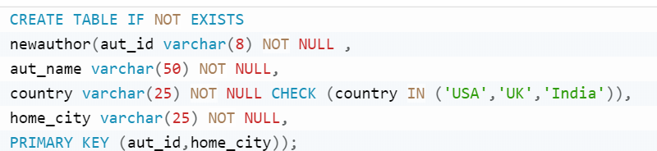
MySQL CREATE TABLE to check values with CHECK CONSTRAINT using different operators

Slide 16
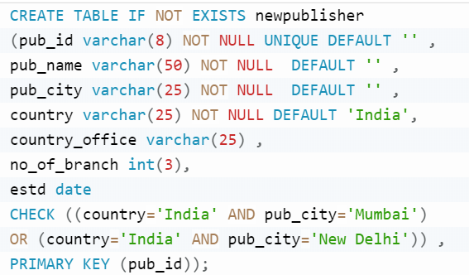
MySQL CREATE TABLE with DEFAULT CONSTRAINT
Example

Slide 17
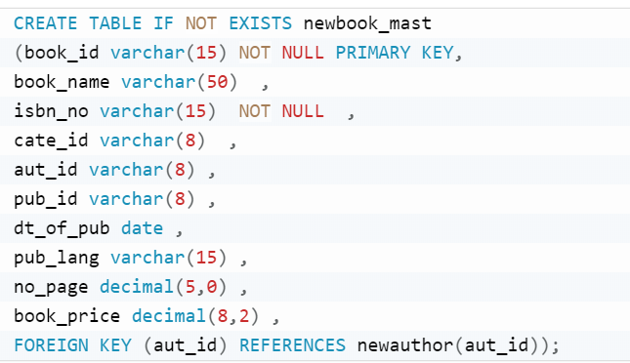
MySQL creating table with FOREIGN KEY CONSTRAINT on single ,multiple column and multiple tables

Slide 18
MySQL: ALTER TABLE Statement
ALTER TABLE - ADD Column
Adding column(s) to a table
ALTER TABLE table_name ADD column_name column-definition;
For example:
ALTER TABLE supplier ADD supplier_name varchar2(50);
Add multiple columns in table
ALTER TABLE contacts ADD last_name varchar(40) NOT NULL AFTER contact_id,
ADD first_name varchar(35) NULL AFTER last_name;
ALTER TABLE - Drop column(s) in a table
ALTER TABLE table_name DROP COLUMN column_name;
For example:
ALTER TABLE supplier DROP COLUMN supplier_name;

Slide 19
MySQL: ALTER TABLE Statement
ALTER TABLE command to add a NOT NULL constraint
ALTER TABLE table_name MODIFY column_name datatype NOT NULL;
ADD UNIQUE CONSTRAINT to a table
ALTER TABLE Persons ADD UNIQUE (ID);
ALTER TABLE Persons ADD CONSTRAINT UC_Person UNIQUE (ID,LastName);
DROP a UNIQUE Constraint
ALTER TABLE Persons DROP INDEX UC_Person;

Slide 20
MySQL: ALTER TABLE Statement
Modify column in table
ALTER TABLE table_name MODIFY column_name column_definition [ FIRST | AFTER column_name ];
Example
ALTER TABLE contacts MODIFY last_name varchar(55) NULL AFTER contact_type, MODIFY first_name varchar(30) NOT NULL;

Slide 21
MySQL: ALTER TABLE Statement
SQL DEFAULT on ALTER TABLE
ALTER TABLE tablename ALTER columnname SET DEFAULT colvalue;
Example
ALTER TABLE Persons ALTER City SET DEFAULT ‘Pune';
DROP a DEFAULT Constraint
ALTER TABLE Persons ALTER City DROP DEFAULT;

Slide 22
MySQL: ALTER TABLE Statement
Rename column in table
ALTER TABLE table_name CHANGE COLUMN old_name new_name column_definition [ FIRST | AFTER column_name ]
Example
ALTER TABLE contacts CHANGE COLUMN contact_type ctype varchar(20) NOT NULL;
Rename table
ALTER TABLE table_name RENAME TO new_table_name;
ALTER TABLE contacts RENAME TO people;

Slide 23
DCL STATEMENTS OF SQL

Slide 24
ACCESS CONTROL Statements SQL
SQL supports discretionary data access control through
the following statements:
GRANT
REVOKE
GRANT: The statement is used to give privileges to other
users.
REVOKE: The statement is used to take away already
given privileges from other users.

Slide 25
Steps
1.Login as root user
2.Create users
3.Give permissions using GRANT
4.Revoke permissions when needed using Revoke

Slide 26
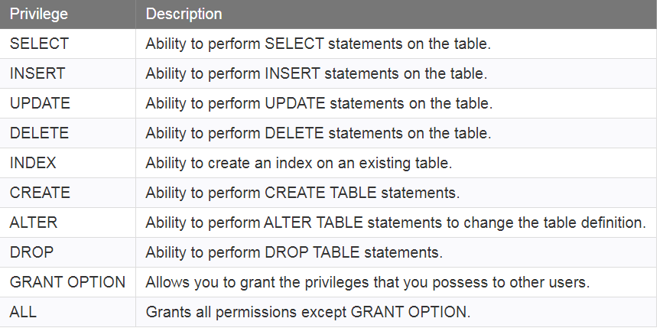
Grant Privileges on Table
Syntax
GRANT privileges ON object TO user;
privileges
Object
The name of the database object that you are granting permissions for. In the case of granting privileges on a table, this would be the table name.
User
The name of the user that will be granted these privileges.

Slide 27
Example
GRANT SELECT, INSERT, UPDATE, DELETE ON contacts TO 'smithj'@'localhost';
GRANT SELECT ON contacts TO 'smithj'@'localhost';
GRANT All ON contacts TO 'smithj'@'localhost';

Slide 28
Revoke Privileges on Table
Syntax
REVOKE privileges ON object FROM user;
REVOKE Delete,Update ON contacts from 'smithj'@'localhost';
REVOKE select ON contacts TO ‘*'@'localhost';
REVOKE All ON contacts TO 'smithj'@'localhost';

Slide 29
Exercise for explanation
Create a database which consist of the following tables with appropriate constraints like primary key, foreign key, check constrains, not null etc.
employee (SSN, ……)
Department(Dnumber, ……)
Dept_Locations(Dnum, Dlocations)
Project(Pnumber,……. )
Works_on(Pnum, Essn, ….)
Dependent(Essn, ……)

Slide 30
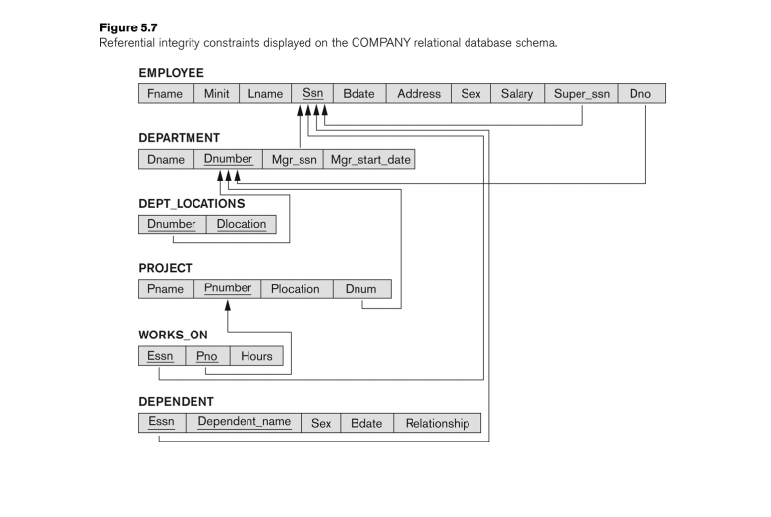
Exercise for explanation(contd…)

Slide 31
Exercises -Batch 1_1
Perform DDL and DCL commands
Create a table with all constraints ,truncate a table, drop a table ,alter table by adding a column , dropping a column, adding and dropping different constraints, modify data type and length of column, rename table , column , create a user, grant different privileges and revoke

Slide 32
Exercises
Create a database which consist of the following tables with appropriate constraints like primary key, foreign key, check constrains, not null etc.(i.e. all Table and column constraints)
Suppliers (Sid, Name, Status, City)
Parts (Pid, Pname, Colour, Weight, City)
Projects (Jid, Jname, City)
Shipment(Sid, Pid, Jid, Qty)
Create a Company database for the Schema Shown on slide No 30 with appropriate constraints like primary key, foreign key, check constrains, not null etc.

Slide 33
Exercises -Batch 1_2
Perform DDL and DCL commands
Create a table with all constraints ,truncate a table, drop a table ,alter table by adding a column , dropping a column, adding and dropping different constraints, modify data type and length of column, , rename table , column , create a user, grant different privileges and revoke

Slide 34
Exercises
Create a database which consist of the following tables with appropriate constraints like primary key, foreign key, check constrains, not null etc.
Hotel (HotelNo, Name, City) HotelNo is the primary key
Room (RoomNo, HotelNo, Type, Price)
Booking (HotelNo, GuestNo, DateFrom, DateTo, RoomNo)
Guest (GuestNo, GuestName, GuestAddress) GuestNo is primary key
Create a Company database for the Schema Shown on slide No 30 with appropriate constraints like primary key, foreign key, check constrains, not null etc.

Slide 35
Exercises -Batch 2_1
Perform DDL and DCL commands
Create a table with all constraints ,truncate a table, drop a table ,alter table by adding a column , dropping a column, adding and dropping different constraints, modify data type and length of column, , rename table , column , create a user, grant different privileges and revoke

Slide 36
Exercises
Create a database which consist of the following tables with appropriate constraints like primary key, foreign key, check constrains, not null etc.
Hotel (HotelNo, Name, City) HotelNo is the primary key
Room (RoomNo, HotelNo, Type, Price)
Booking (HotelNo, GuestNo, DateFrom, DateTo, RoomNo)
Guest (GuestNo, GuestName, GuestAddress) GuestNo is primary key
Create a Company database for the Schema Shown on slide No 30 with appropriate constraints like primary key, foreign key, check constrains, not null etc.

Slide 37
Exercises -Batch 2_2
Perform DDL and DCL commands
Create a table with all constraints ,truncate a table, drop a table ,alter table by adding a column , dropping a column, adding and dropping different constraints, modify data type and length of column, , rename table , column , create a user, grant different privileges and revoke

Slide 38
Exercises
Create a database which consist of the following tables with appropriate constraints like primary key, foreign key, check constrains, not null etc.
classroom(building, room number, capacity)
department(dept name, building, budget)
course(course id, title, dept name, credits)
instructor(ID, name, dept name, salary)
section(course id, sec id, semester, year, building, room number, time slot id)
teaches(ID, course id, sec id, semester, year)
student(ID, name, dept name, tot cred)
takes(ID, course id, sec id, semester, year, grade)
advisor(s ID, i ID)
time slot(time slot id, day, start time, end time)
prereq(course id, prereq id)
Create a Company database for the Schema Shown on slide No 30 with appropriate constraints like primary key, foreign key, check constrains, not null etc.

Slide 39
Extra Exercises
Perform DDL and DCL commands
Create a table with all constraints ,truncate a table, drop a table ,alter table by adding a column , dropping a column, adding and dropping different constraints, modify data type and length of column, , rename table , column , create a user, grant different privileges and revoke

Slide 40
Exercises
Create a database which consist of the following tables with appropriate constraints like primary key, foreign key, check constrains, not null etc.
employee (employee name, street, city) ,employee name is primary key
works (employee name, company name, salary)
company (company name, city) ,company name is primary key
manages (employee name, manager name
Create a database which consist of the following tables with appropriate constraints like primary key, foreign key, check constrains, not null etc.
Emp (eno,ename, job,hiredate,salary,commission,deptno,)
dept(deptno,deptname,location)
- eno is primary key in emp, deptno is primary key in dept

Slide 41
Exercises
Create a database which consist of the following tables with appropriate constraints like primary key, foreign key, check constrains, not null etc.
Project(project_id,proj_name,chief_arch) project_id is primary key
Employee(Emp_id,Emp_name) Emp_id is primary key
Assigned-To(Project_id,Emp_id)
Create a database which consist of the following tables with appropriate constraints like primary key, foreign key, check constrains, not null etc.
Employee(emp_no,name,skill,pay-rate) eno primary key
Position(posting_no,skill) posting_no primary key
Duty_allocation(posting_no,emp_no,day,shift)

Slide 42
Exercises
Create a database which consist of the following tables with appropriate constraints like primary key, foreign key, check constrains, not null etc.
emp (eno, ename, Zip, hdate)
parts(pno, pname, qty_on_hand, price)
customer(cno, cname,street, Zip, phone)
order(ono, cno, receivedate, shippeddate)
odertails(ono, pno, qty)
zipcode(Zip, city)

Slide 43

Thank You!

